Slide 1
Programming 4
11.1 Intro to Programming Paradigms
Semester 2, 2019

Slide 2
Going forward
Last week was the end of the C++ CLI content
This week and beyond we are going to look
into different programming paradigms
Roguelike assignment is due next Friday 5pm

Slide 3
Paradigms and syntax
Programming languages are built on a series
of choices
Paradigm is an approach used to solve a problem
or do a task
Syntax refers to a programming languages textual features

Slide 4
Paradigms
Imperative
Functional
Declarative
Logical

Slide 5
Imperative
A step by step sequence of instructions
Changes the state of the program
Examples of imperative languages are C#, Java
and C++

Slide 6
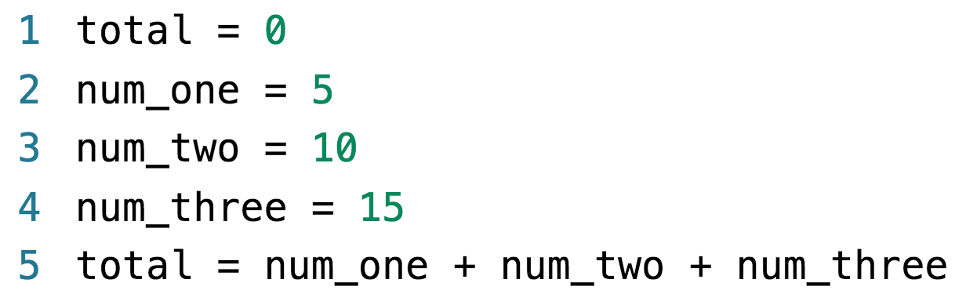
Example – Python

Slide 7
Functional
Based on lambda calculus.
Functional logic:
Functions are first-class objects
Programs are stateless.
High order functions
No looping…
Supports the four main principles of OO
Examples of functional languages are Haskell and F#

Slide 8
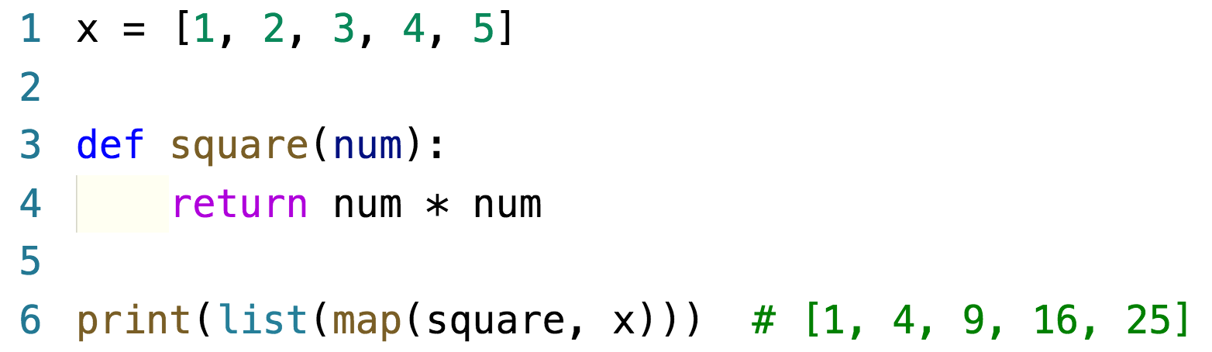
Example – Python

Slide 9
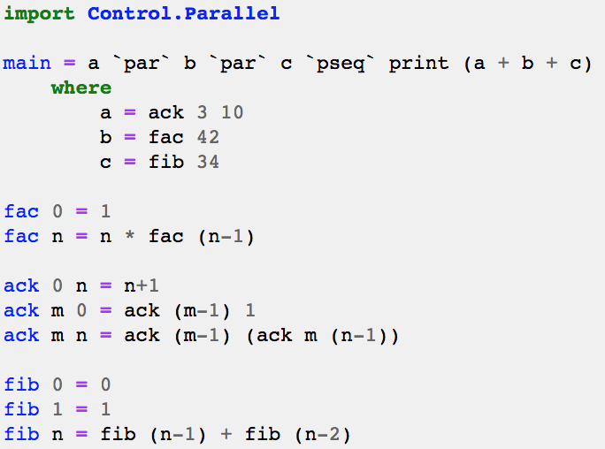
Example – Haskell

Slide 10
Declarative
Building logic without describing its flow
Examples of declarative languages are HTML,
XML and SQL

Slide 11
Logical
Based on predicate calculus
Statements are expressed as facts and rules
Examples of logical languages are Alma-0 and Prolog

Slide 12
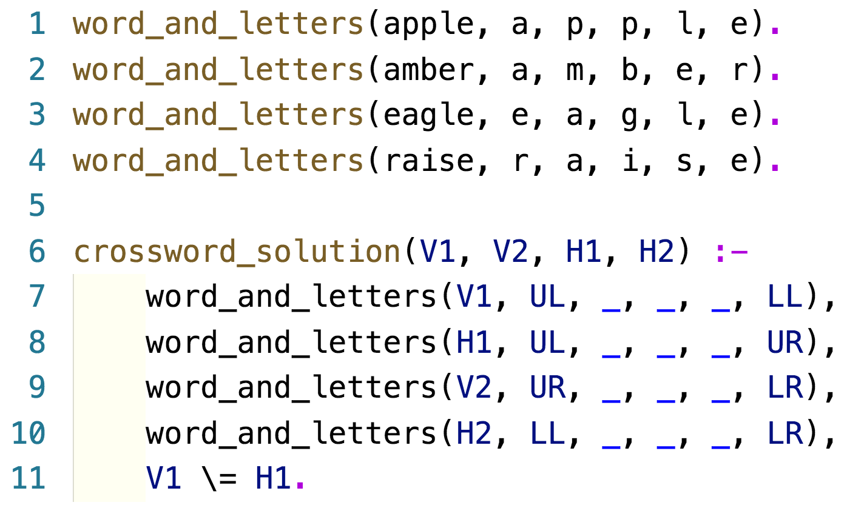
Example – Prolog

Slide 13
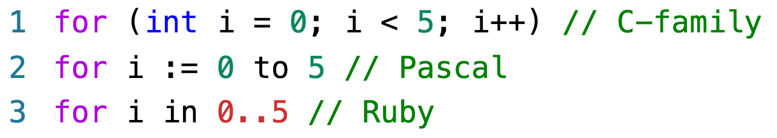
Syntax
A set of rules
Distinguished into three levels:
Words
Phrases
Context
Examples include:

Slide 14
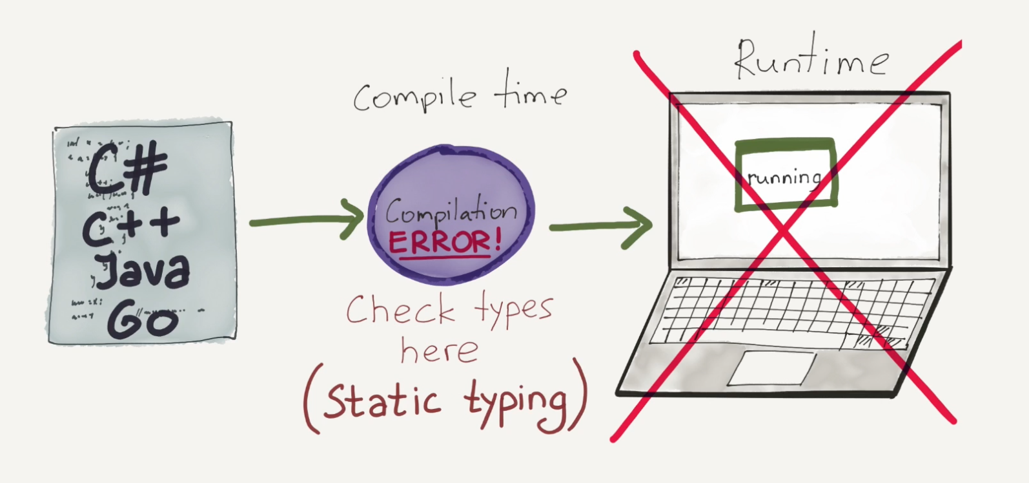
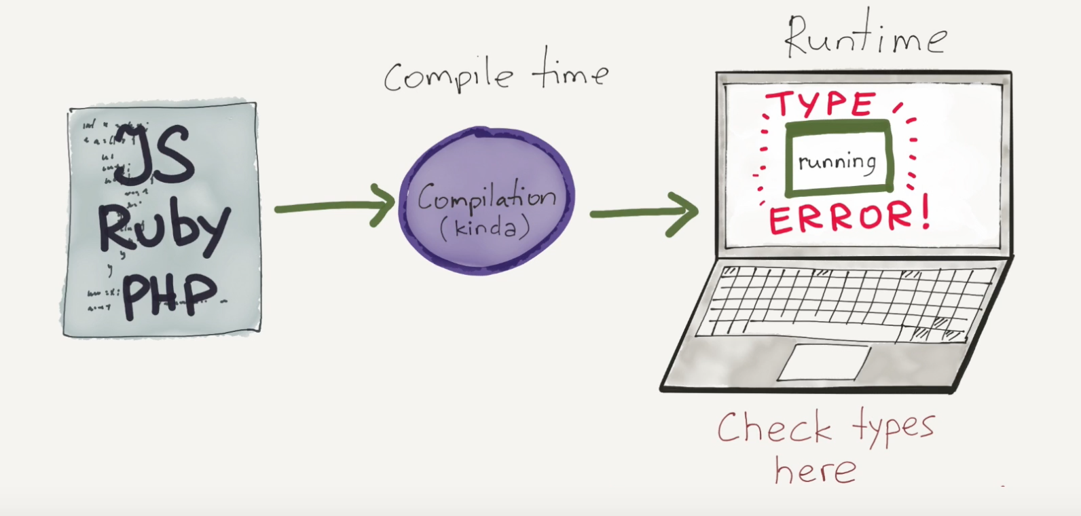
Types
Strong typed vs. weak typed
Static typed vs. dynamic typed

Slide 15
Python
World’s fastest growing programming language
An imperative/object-oriented programming
language with functional features
Solve problems in less time with fewer lines of code
Compiles to byte code, then interpreted
High level language – garbage collection
Cross-platform
Huge community
Large ecosystem

Slide 16
Python
Use # for single-line comments and ‘’’ for
multi-line comments
No semi-colons at the end of statements
Use indentation for code blocks
Tabs or spaces – convention is one tab and
four spaces

Slide 17
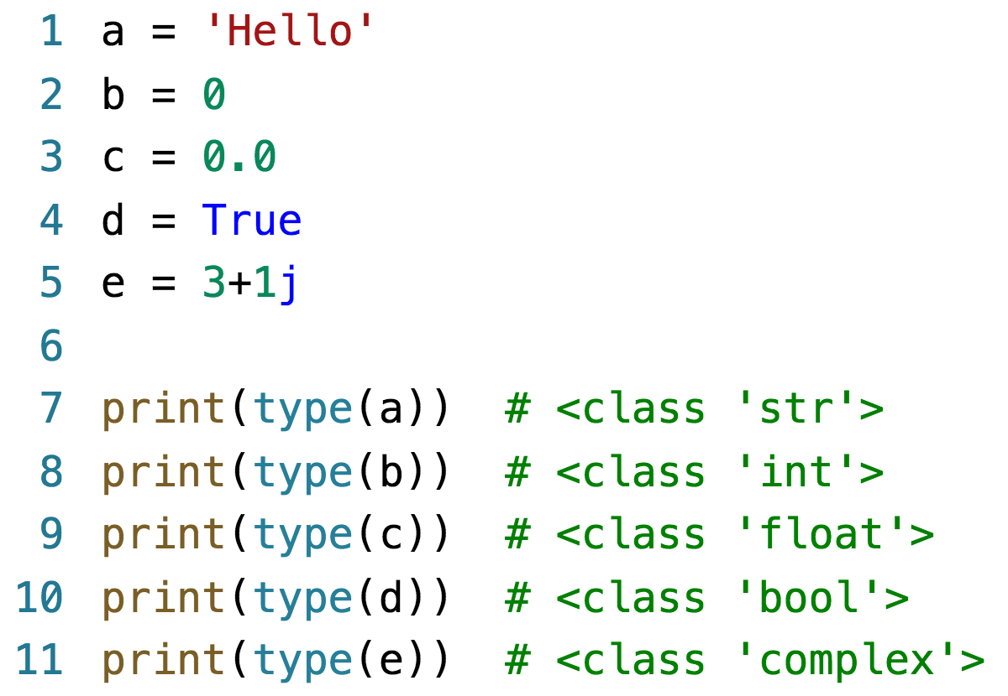
Python
Six principal in-built types in Python
Types are not declared, they are inferred

Slide 18
Python
Supports basic operators including:
Arithmetic
Comparison
Logical
Assignment
Special Operators

Slide 19
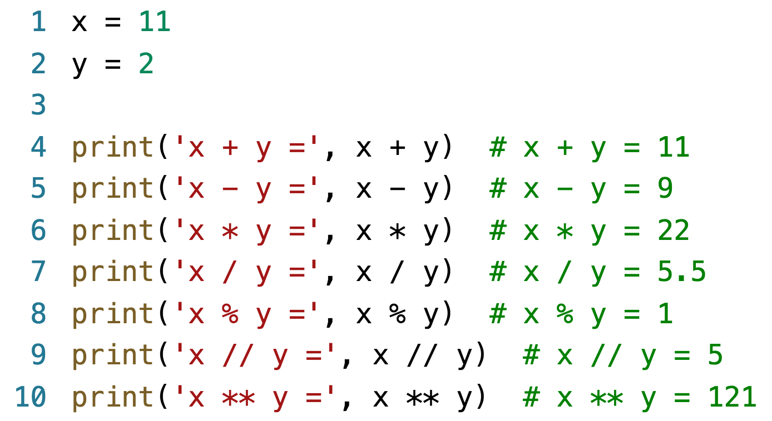
Example – arithmetic operators

Slide 20
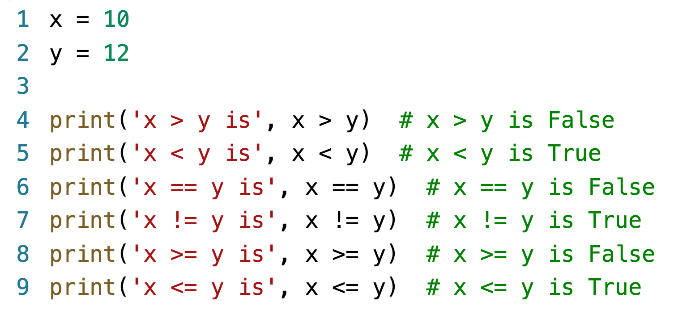
Example – comparison operators

Slide 21
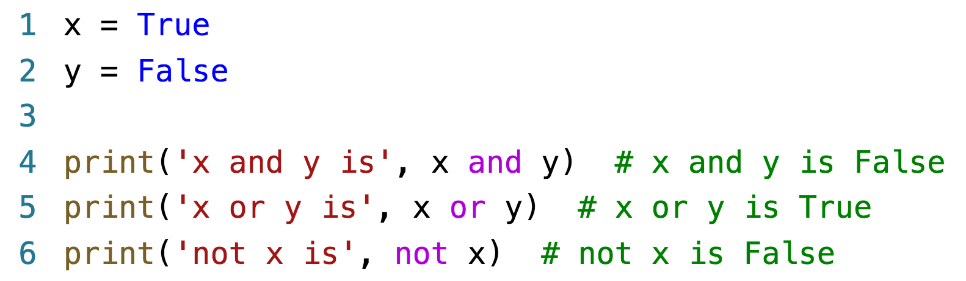
Example – logical operators

Slide 22
Example – assignment operators
Operator | Example | Equivalent
= | x = 5 | x = 5
+= | x += 5 | x = x + 5
-= | x -= 5 | x = x - 5
*= | x *= 5 | x = x * 5
/= | x /= 5 | x = x / 5
%= | x %= 5 | x = x % 5
//= | x //= 5 | x = x // 5
**= | x **= 5 | x = x ** 5

Slide 23
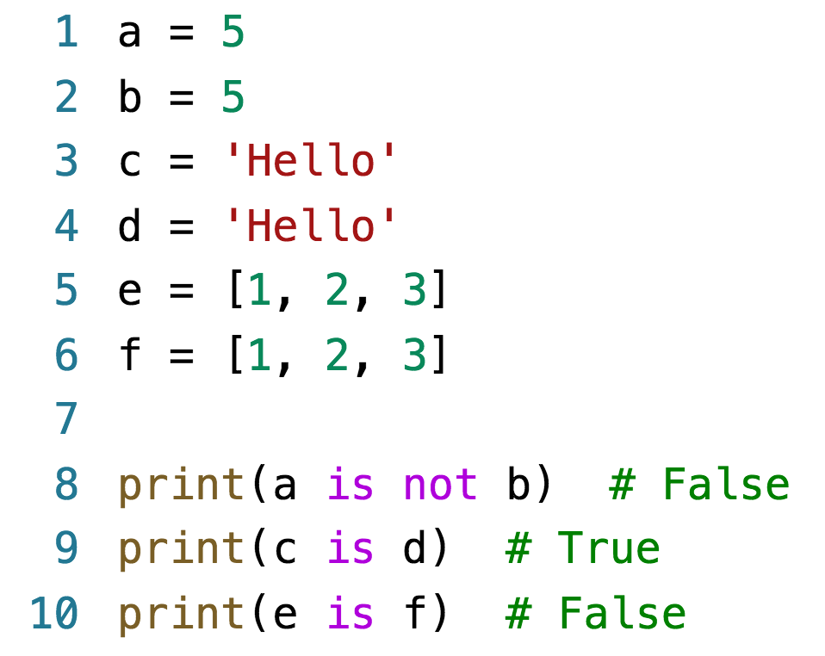
Example – special operators

Slide 24
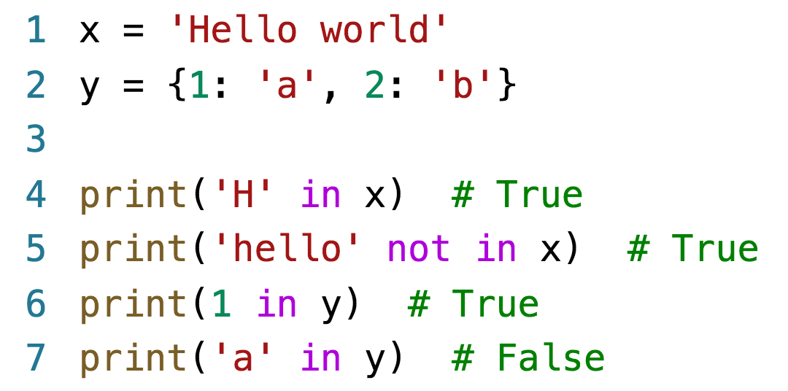
Example – special operators

Slide 25
Casting
Implicit – automatically performed by the Python interpreter
Explicit – the type of object is converted using a predefined function

Slide 26
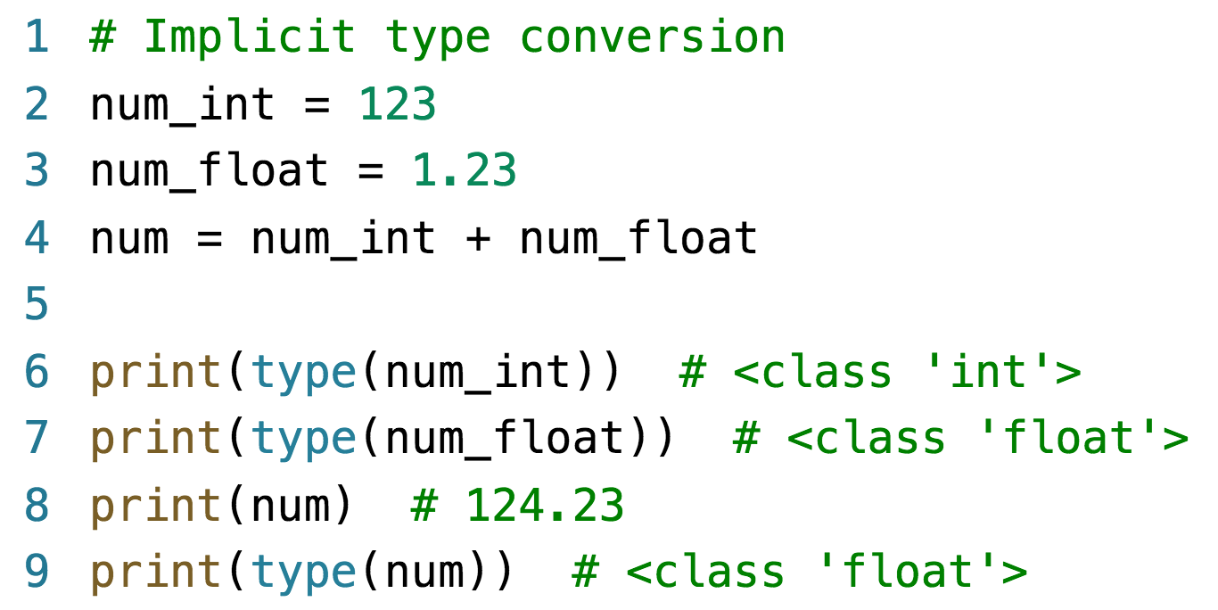
Casting – implicit type conversion

Slide 27
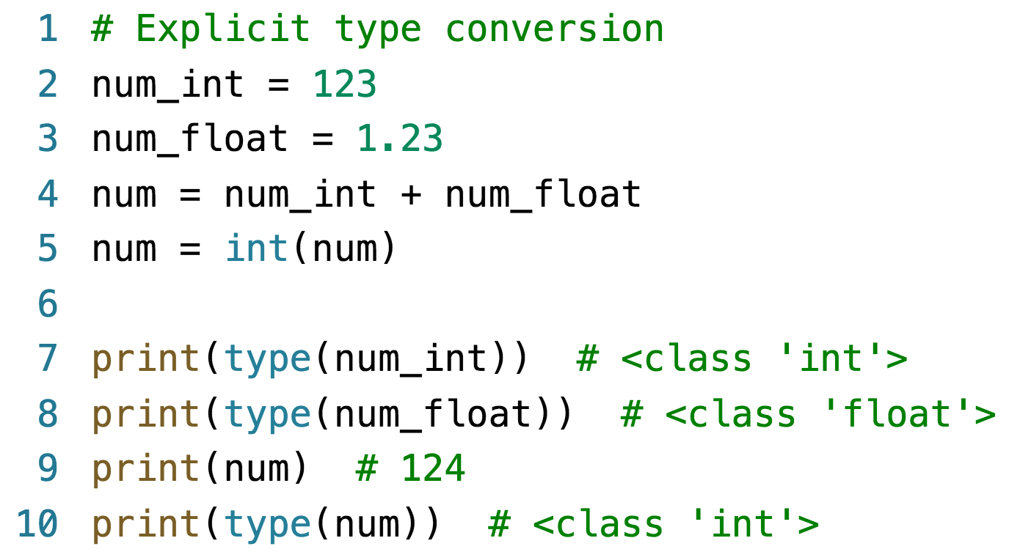
Casting – explicit type conversion

Slide 28
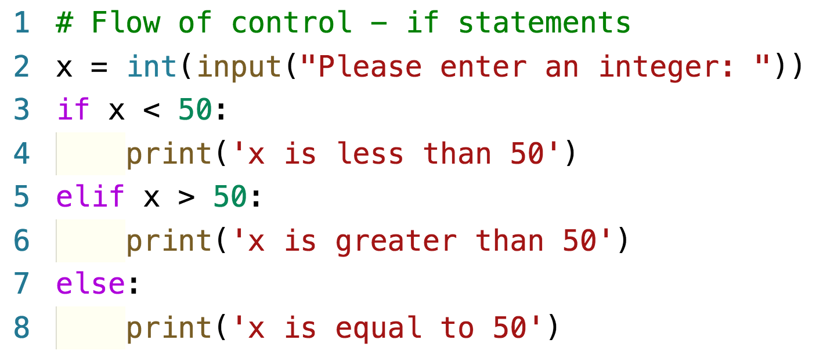
Flow of control
If statement
For statement
While statement

Slide 29
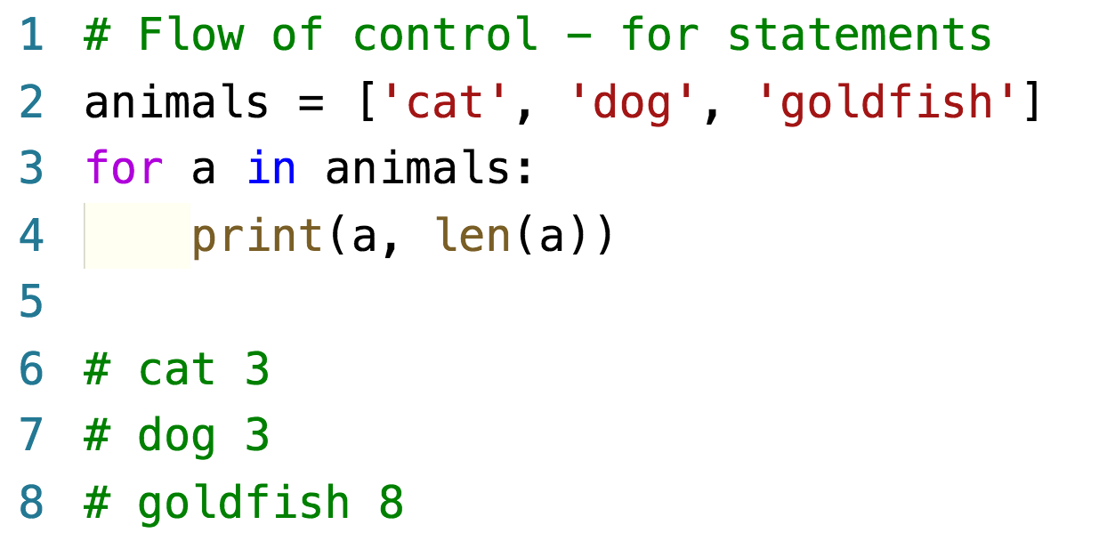
Flow of control – for statements
For statements are much closer to foreach
statements

Slide 30
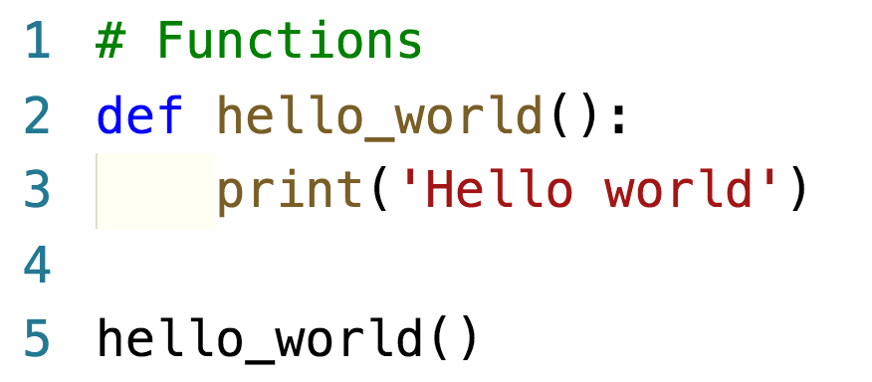
Functions

Slide 31
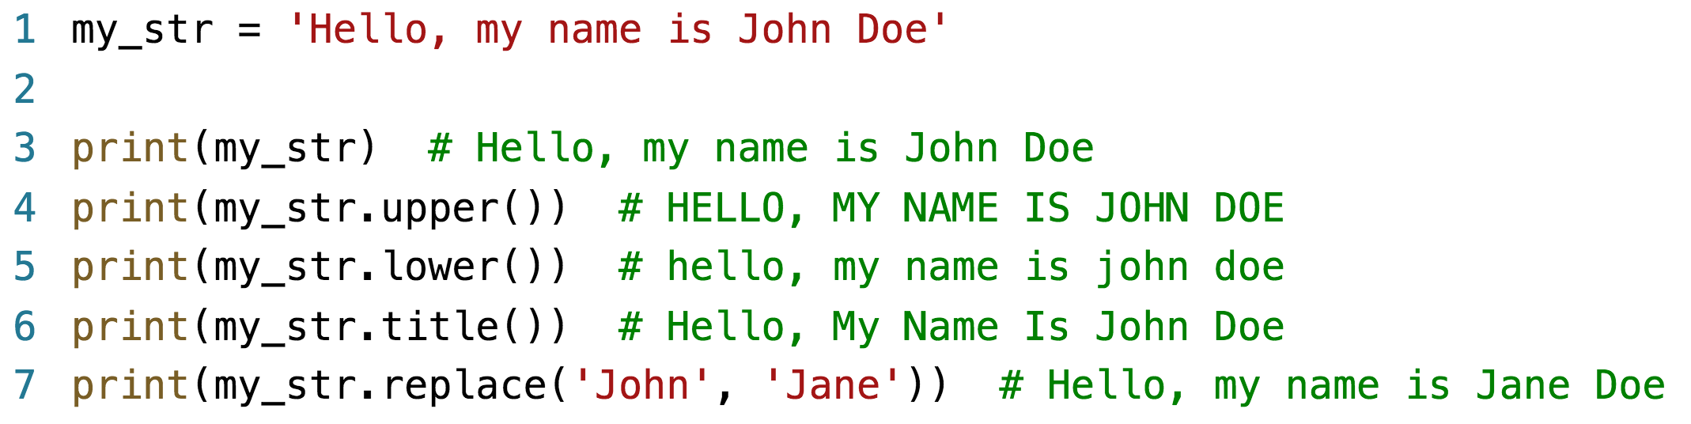
String functions

